Slide 1
Year 3: Maths Knowledge Mat
Counting from 0
Counting in multiples of 4 0, 4, 8, 12, 16, 20, 24, 28, 32…
Counting in multiples of 8 0, 8, 16, 24, 32, 40, 48…
Counting in multiples of 50 0, 50, 10, 150, 20, 250, 300…
Counting in multiples of 100 0, 100, 200, 300, 400, 500…
Place value | Thousands | Hundreds | Tens | Ones |  | Tenths
1238 | 1 | 2 | 3 | 8 |  | 0
58.9 | 0 | 0 | 5 | 8 |  | 9
3050.4 | 3 | 0 | 5 | 0 |  | 4
Multiplication Tables
x | 3 | 4 | 8
1 | 3 | 4 | 8
2 | 6 | 8 | 16
3 | 9 | 12 | 24
4 | 12 | 16 | 32
5 | 15 | 20 | 40
6 | 18 | 24 | 48
7 | 21 | 28 | 56
8 | 24 | 32 | 64
9 | 27 | 36 | 72
10 | 30 | 40 | 80
11 | 33 | 44 | 88
12 | 36 | 48 | 96
Fractions
1
$$\frac{1}{2}$$ |  |  |  |  |  |  |  |  |  | $$\frac{1}{2}$$
$$\frac{1}{3}$$ |  |  |  |  |  |  | $$\frac{1}{3}$$ |  |  |  |  |  | $$\frac{1}{3}$$
$$\frac{1}{4}$$ |  |  |  |  | $$\frac{1}{4}$$ |  |  |  |  | $$\frac{1}{4}$$ |  |  |  |  | $$\frac{1}{4}$$
$$\frac{1}{5}$$ |  |  |  | $$\frac{1}{5}$$ |  |  |  |  | $$\frac{1}{5}$$ |  | $$\frac{1}{5}$$ |  |  |  |  | $$\frac{1}{5}$$
$$\frac{1}{6}$$ |  |  | $$\frac{1}{6}$$ |  |  |  | $$\frac{1}{6}$$ |  |  | $$\frac{1}{6}$$ |  |  | $$\frac{1}{6}$$ |  |  |  | $$\frac{1}{6}$$
$$\frac{1}{8}$$ |  | $$\frac{1}{8}$$ |  |  | $$\frac{1}{8}$$ |  |  | $$\frac{1}{8}$$ |  | $$\frac{1}{8}$$ |  | $$\frac{1}{8}$$ |  |  | $$\frac{1}{8}$$ |  |  | $$\frac{1}{8}$$
$$\frac{1}{10}$$ | $$\frac{1}{10}$$ |  |  | $$\frac{1}{10}$$ |  | $$\frac{1}{10}$$ |  |  | $$\frac{1}{10}$$ | $$\frac{1}{10}$$ | $$\frac{1}{10}$$ |  |  | $$\frac{1}{10}$$ |  | $$\frac{1}{10}$$ |  |  | $$\frac{1}{10}$$
Equivalent
Fractions
Examples:
$$\frac{1}{2} = \frac{2}{4}$$
$$\frac{5}{10} = \frac{4}{8}$$
Adding fractions
$$\frac{3}{8} + \frac{2}{8} = \frac{5}{8}$$
Vocabulary
100 | hundred
1000 | thousand
+ - X ÷ | inverse operations
$$\frac{1}{2}$$ | Numerator
$$\frac{1}{2}$$ | Denominator
Formal methods of addition, subtraction and short multiplication and division
768 + 653 becomes | 862 - 514 becomes | 934 - 456 becomes | 26 x 8 becomes | 78 ÷ 6 becomes
 | 8 | 12 | 1
 | 9 | 3 | 4
- | 4 | 5 | 6
 | 4 | 7 | 8
 | 1 | 3
 |  | 1
6 | 7 | 8
 | 7 | 6 | 8
+ | 6 | 5 | 3
1 | 4 | 2 | 1
 | 1 | 1
 | 8 | 6 | 2
- | 5 | 1 | 4
 | 3 | 4 | 8
 | 2 | 6
x |  | 8
2 | 0 | 8
 | 4

Slide 2
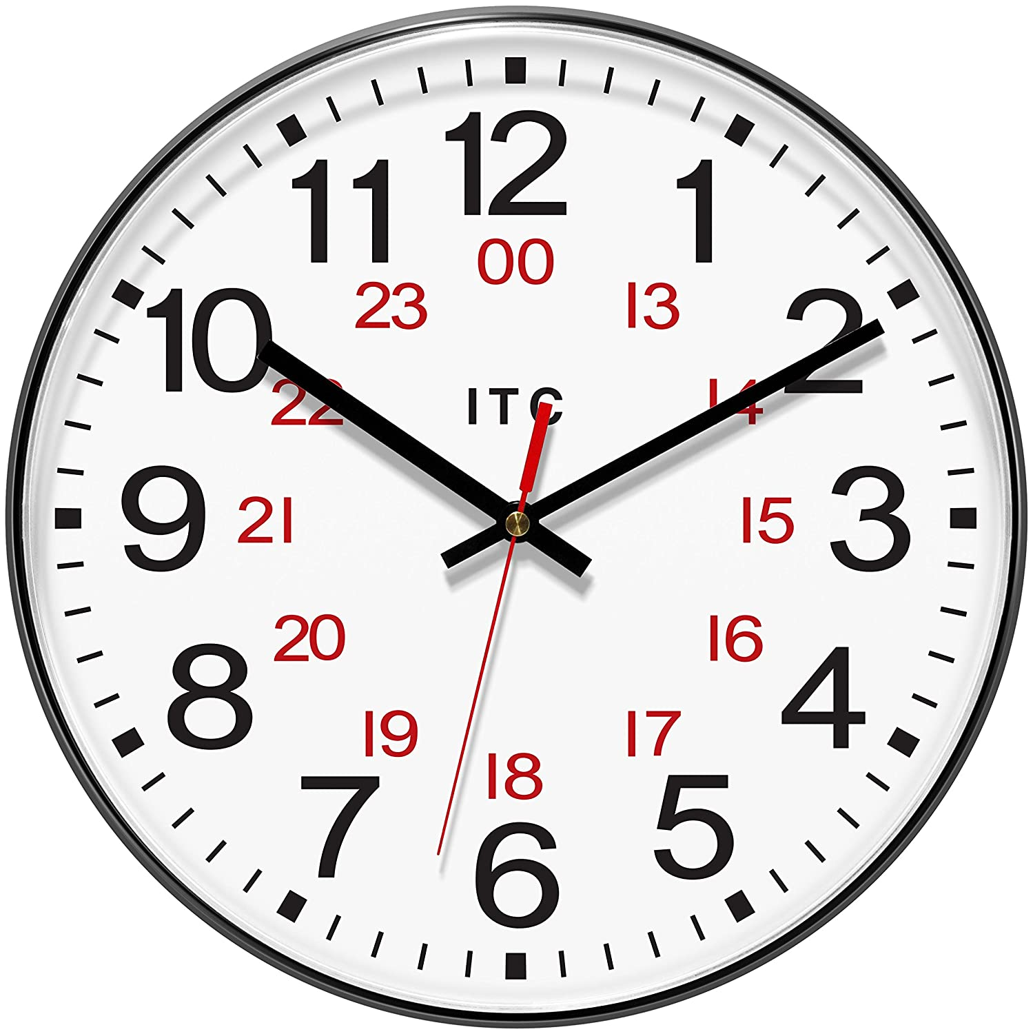
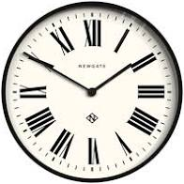
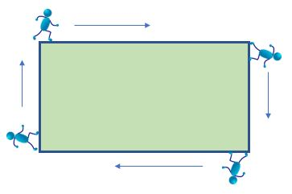
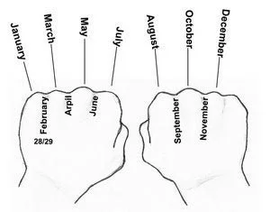
Year 3: Maths Knowledge Mat
Time – Sticky Knowledge
24 hour clocks The time is 10.10 in the morning or 22.10 in the evening in 24 hour time. | Roman numerals This clock is showing X to II or 10 to 2. On some clocks the 4 is IIII and sometimes it is IV
a.m. is from midnight until mid-day (noon) 1 to 12 in 24 hour clock time | p.m. is from mid-day (noon) until midnight 13 to 24 in 24 hour clock time
There are 365 days in a year. A leap year has 366 days. This is February 29th and happens every 4 years.
January 31 days ‘Knuckle Mnemonic’ February 28 days March 31 days April 30 days May 31 days June 30 days July 31 days August 31 days September 30 days October 31 days November 30 days December 31 days
Perimeter
Perimeter is the distance around a 2D shape
32m
20m
20m
32m
Non symmetrical (irregular) polygons
Lines
Parallel Perpendicular
Polygon/Shape | Regular | Irregular
Triangle
Quadrilateral
Pentagon
Hexagon
Heptagon
Octagon
Angles
Acute angle
Less than 90°
Right angle
Exactly 90°
Obtuse angle
More than 90°
Less than 180°
Reflex angle
More than 180°
Less than 360°

