Slide 1
Year 6: Maths Knowledge Mat
Rounding
8,378,543 To the nearest 10,000 is 8,380,000 To the nearest 100,000 is 8.400,000 To the nearest 1,000,000 is 8,000,000 To the nearest 10,000,000 is 10,000,000
Multiplying a fraction by a fraction
$\frac{3}{5}$ x $\frac{6}{8}= \frac{3 x 6}{5 x 7}= \frac{18}{35}$ $\frac{3}{4}$ x $\frac{1}{3}$ = $\frac{3 x 1}{4 x 3}$ = $\frac{3}{12}$ = reduces to $\frac{1}{4}$
Percentages
x
On a calculator 36% of 76 0.36 x 76 | Increasing Increase £70 by 14% 14% of 70 = 0.14 x 70 = £9.80 New amount = £70 + £9.80 =£79.80
Fraction to % $\frac{15}{20}$ = $\frac{75}{100}$ = 75% Or 15÷20 x 100 = 75% | Decreasing Decrease £70 by 14% 14% of 70 = 0.14 x 70 = £9.80 New amount = £70 - £9.80 =£60.20
Without a calculator 50% - half 25% - half and half 75% - 50% + 25% | 10% - divide by 10 5% - half 10% 20% - double 10%
x
Change to a decimal and multiply
x
x
Calculations with mixed numbers
Adding fractions
$\frac{1}{2}$+ $\frac{1}{3}$ = ? $\frac{1}{2}$ = $\frac{3}{6}$ $\frac{1}{3}$ = $\frac{2}{6}$ $\frac{3}{6}$ + $\frac{2}{6}$ = $\frac{5}{6}$
x5
Add Mixed Numbers |  | Subtract Mixed Numbers
$8\frac{1}{2}$ + 3$\frac{3}{4}$ = $\frac{17}{2}+ \frac{15}{4}$ = $\frac{17 2}{2 2}$ + $\frac{15}{4}$ = $\frac{34}{4}$ + $\frac{15}{4}$ = $\frac{49}{4}$ = 12 $\frac{1}{4}$ | Change to improper fractions Change to common denominator Add the numerators Change to mixed numbers | 8$\frac{1}{2}$ - 4$\frac{3}{4}$ = $\frac{17}{2}$ - $\frac{15}{4}$ = $\frac{17 2}{2 2}$ - $\frac{15}{4}$ = $\frac{34}{4}$ - $\frac{15}{4}$ = $\frac{19}{4}$ = 4 $\frac{3}{4}$ | Change to improper fractions Change to common denominator Subtract the numerators Change to mixed numbers
x5
x 3
x 3
x 2
x 2
x
x
x
x
Mean Average
The sum of all data points divided by the number of data points
BODMAS
B → Bracket O → Of D → Division M → Multiplication A → Addition S → Subtraction -------------------------------------------------- BODMAS EXAMPLE 40 – (5 x 2² + 7) Brackets 1st then use ODMAS inside the brackets Answer = 13
Ratio
Ratio compares values. A ratio says how much of one thing there is compared to another thing. Ratio 3:1. There are 3 blue squares to 1 yellow square.
Formal methods of multiplication and division
134 x 27 becomes | 564 ÷ 15 becomes | 432 ÷ 15 becomes | 384 ÷ 11 becomes
 | 2 | 2
 | 1 | 3 | 4
X |  | 2 | 7
2 | 6 | 8 | 0
 | 9 | 3 | 8
3 | 6 | 1 | 8
1 | 1
15 | 5 | 6 | 4
 | 4 | 5 | 0 | 15 X 30
 | 1 | 1 | 4
 | 1 | 0 | 5 | 15 X 7
 |  | 3 | 7
$\frac{9}{15}$ = $\frac{3}{5}$ Answer: 37 $\frac{3}{5}$
 |  | 2 | 8 | . | 8
15 | 4 | 3 | 2 | . 0
 | 3 | 0
 | 1 | 3 | 2
 | 1 | 2 | 0
 |  | 1 | 2 | 0
 |  | 1 | 2 | 0
 |  |  |  | 0
Answer: 28.8
 |  | 3 | 4 | r10
 |  | 5
11 | 3 | 8 | 4
Answer: 34 $\frac{10}{11}$
40 – (5 x 4 + 7) | (2²)
40 – (20 + 7) | (Multiply 5 x 4)
40 - 27 | (Add 20 + 7)

Slide 2
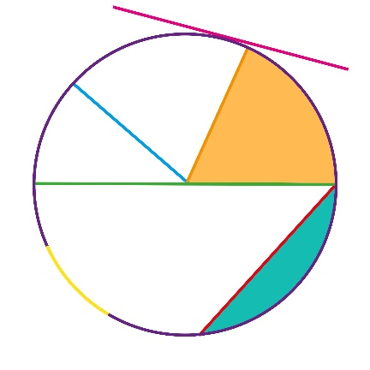
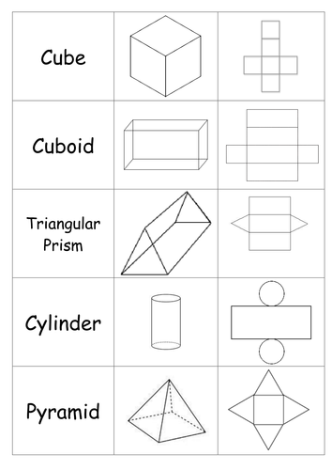
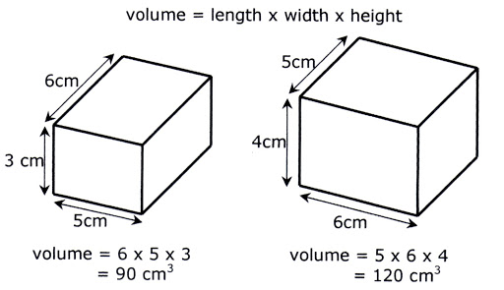
Year 6: Maths Knowledge Mat
Algebra
Circles
The diameter is twice the radius
Angles in a triangle
a° + b° + c° = 180° 38° + 60° + c° = 180° c° = 180° - 98 c° = 82°
Nets of 3D shapes
One step equation, e.g. Divide both sides by 4 Two step equation, e.g. Add 10 to both sides Divide both sides by 6 Equations with brackets, e.g. Remove the grouping symbols Subtract 6 from both sides Divide both side by 3 | 3x = 12 x = 4 5y – 10 = 20 5y = 30 y = 6 4(x + 3) = 28 4x + 12 =28 4x = 16 X = 4
tangent
c°
radius
a°
b°
sector
diameter
c°
arc
segment
chord
38°
48°
Area of a triangle
Area = $\frac{1}{2}$ x b x h = $\frac{ }{ 2 }$
circumference
bh
Square Numbers |  | Square Roots
1² | 1 | √1 | 1
2² | 4 | √4 | 2
3² | 9 | √9 | 3
4² | 16 | √16 | 4
5² | 25 | √25 | 5
6² | 36 | √36 | 6
7² | 49 | √49 | 7
8² | 64 | √64 | 8
9² | 81 | √81 | 9
10² | 100 | √100 | 10
11² | 121 | √121 | 11
12² | 144 | √144 | 12
13² | 169 | √169 | 13
Cube Numbers |  | Cube Roots
1³ | 1 | √1 | 1
2³ | 8 | √8 | 2
3³ | 27 | √27 | 3
4³ | 64 | √64 | 4
5³ | 125 | √125 | 5
h
b
Volume
Vocabulary
factors | numbers that you multiply together to get other numbers
multiple | the result of multiplying a number by an integer
HCF | Highest Common Factor - the largest factor shared by two or more numbers
LCM | Lowest Common Multiple - the smallest number that is a multiple of two or more numbers.

