Slide 1
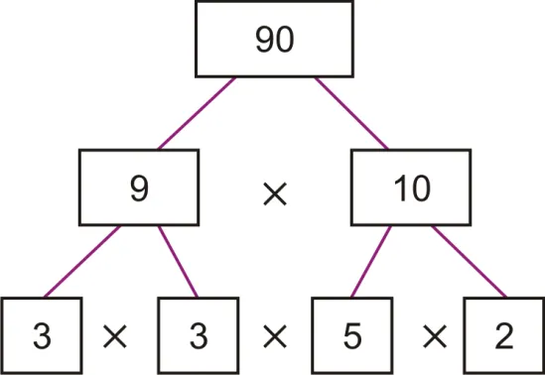
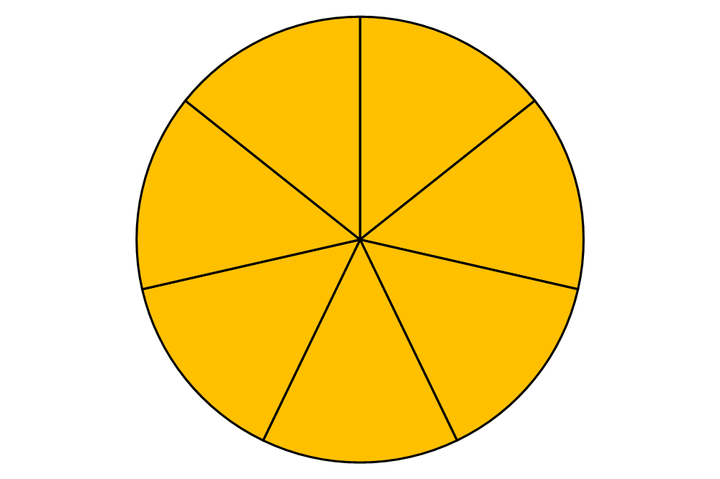
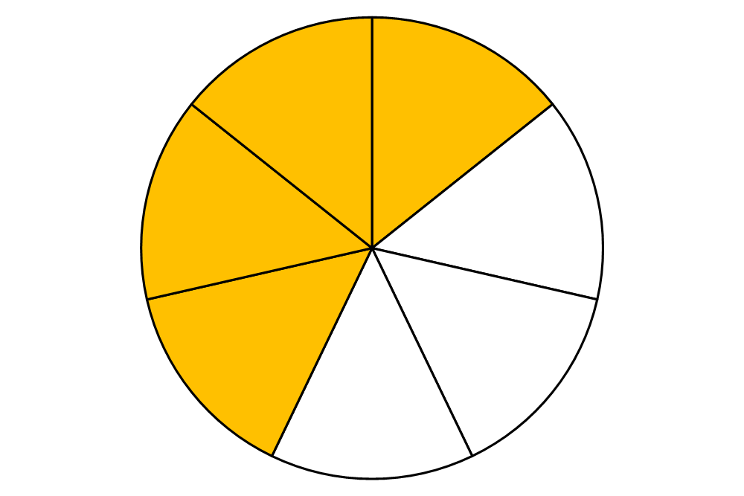
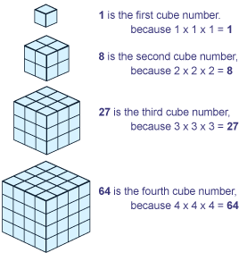
Year 5: Maths Knowledge Mat
Rounding
78,543 To the nearest 10 is 78,540 To the nearest 100 is 78,500 To the nearest 1000 is 79,000 To the nearest 10,000 is 80,000 To the nearest 100,000 is 100,000
67.53 To the nearest 10 is 70 To the nearest whole number is 68 To one decimal place is 67.6
Multiplying a fraction by a whole number
If you have a proper fraction multiplied by a whole number, it is going to be less than that whole number $\frac{3}{5}$ x 2 $\frac{3}{5}$ x $\frac{2}{1}$ = $\frac{6}{5}$ = 1 $\frac{1}{5}$
Prime Numbers
Prime factors
1 | 2 | 3 | 4 | 5 | 6 | 7 | 8 | 9 | 10
11 | 12 | 13 | 14 | 15 | 16 | 17 | 18 | 19 | 20
21 | 22 | 23 | 24 | 25 | 26 | 27 | 28 | 29 | 30
31 | 32 | 33 | 34 | 35 | 36 | 37 | 38 | 39 | 40
41 | 42 | 43 | 44 | 45 | 46 | 47 | 48 | 49 | 50
51 | 52 | 53 | 54 | 55 | 56 | 57 | 58 | 59 | 60
61 | 62 | 63 | 64 | 65 | 66 | 67 | 68 | 69 | 70
71 | 72 | 73 | 74 | 75 | 76 | 77 | 78 | 79 | 80
81 | 82 | 83 | 84 | 85 | 86 | 87 | 88 | 89 | 90
91 | 92 | 93 | 94 | 95 | 96 | 97 | 98 | 99 | 100
Converting a mixed number to an improper fraction
Percentages %
‘part per hundred’ 50% = $\frac{50}{100}$ 25% = $\frac{25}{100}$ 50% of 100 = 50 25% of 100 = 25 50% of 200 = 100 25% of 200 = 50 50% of 300 = 150 25% of 300 = 75 $\frac{1}{2}$ = 0.5 = 50% $\frac{1}{4}$ = 0.25 = 25% $\frac{1}{5} =$ 0.2 = 20% $\frac{2}{5}=$0.4 = 40%
Place value Each row divides by 10 | Tens | Ones |  | tenths | hundredths | thousandths
36.7 | 3 | 6 |  | 7 | 0 | 0
3.67 | 0 | 3 |  | 6 | 7 | 0
0.367 | 0 | 0 |  | 3 | 6 | 7
36.7 = 36$\frac{7}{10}$ 3.67 = 3$\frac{67}{100}$ 0.367 = $\frac{367}{1000}$
1$\frac{4}{7}$ = $\frac{11}{7}$
Square and cubed numbers
1² = 1 x 1 = 1 2² = 2 x 2 = 4 3² = 3 x 3 = 9 4² = 4 x 4 = 16 5² = 5 x 5 = 25 6² = 6 x 6 = 36 7² = 7 x 7 = 49 8² = 8 x 8 = 64 9² = 9 x 9 = 81 10² = 10 x 10 = 100
Formal methods of multiplication and division
3741 x 6 becomes | 485 ÷ 11 becomes | 37 x 26 becomes | 134 x 27 becomes
 | 2
 | 3 | 4
X | 2 | 6
6 | 8 | 0
2 | 0 | 4
8 | 8 | 4
 | 2 | 2
 | 1 | 3 | 4
X |  | 2 | 7
2 | 6 | 8 | 0
 | 9 | 3 | 8
3 | 6 | 1 | 8
1 | 1
 | 3 | 7 | 4 | 1
X |  |  |  | 6
2 | 2 | 4 | 4 | 6
 | 4 | 2
 |  | 4 | 4 | r1
 |  |  | 4
11 | 4 | 8 | 5

Slide 2
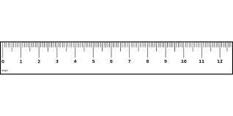
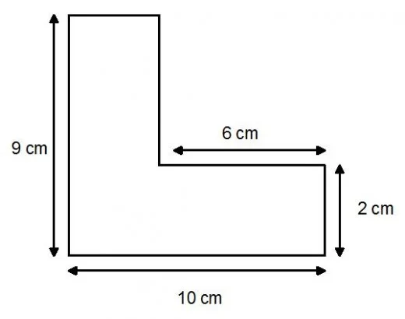
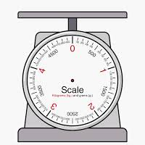
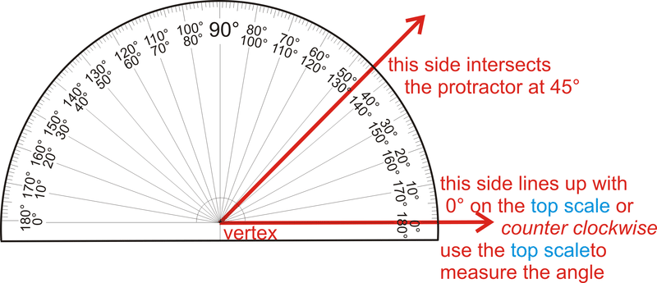
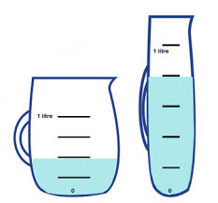
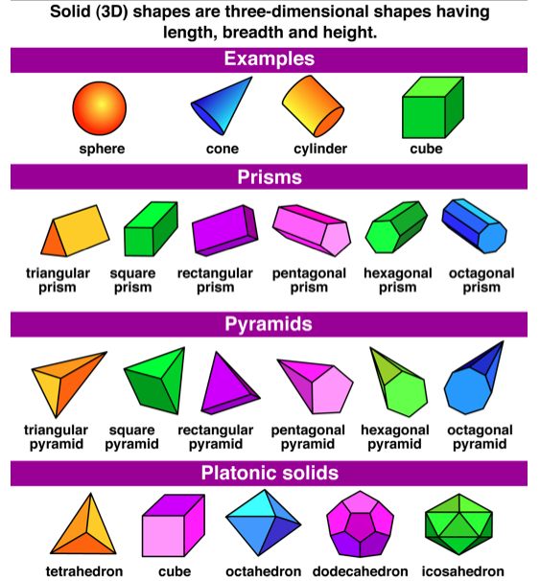
Year 5: Maths Knowledge Mat
Measures – Sticky Knowledge
1 km = 1000 m 1 m = 100 cm 1 cm = 10 mm 1 kg = 1000 g 1 l = 1000 ml | Imperial measures 1 mile = 1.6 km I yard = 9.1 m 1 foot = 30 cm 1 inch = 2.54 cm 1 lb (pound) = 0.45 kg 1 pint = 0.57 litre
Perimeter
This must be 4 cm (10cm – 6cm)
Angles
Right angle
Exactly 90°
Straight line
= 180°
Complete turn
= 360°
This must be 7cm
(9cm – 2cm)
Acute angle
Less than 90°
Obtuse angle
Between 90°
and 180°
Reflex angle
greater than 180°
Using a protractor
3D Shapes
Roman Numerals
Coordinates
P has been reflected in the x axis | The shape has been reflected in the dotted line y=x+2
Symbol | Value
I | 1
V | 5
X | 10
L | 50
C | 100
D | 500
M | 1000
Dates
2020 = MMXX
2021 = MMXXI
2022 = MMXXII
2023 = MMXXIII
2024 = MMXXIV
1066 = MLXVI
1939 = MCMXXXIX
3
7
2
p(2,2)
6
1
5
4
-3
-2
-1
1
2
3
3
-1
2
-2
p(2,-2)
1
-3
0
1
2
3
4
5
6
7

